Slide 1
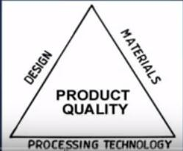
Assist.Prof.Dr. Dhia ahmed
Materials
-metals
-polymers Ceramics
Composite materials
It is made of two or three different phases to
make a single phase that gives better properties
Polymers composite, ceramic composite ….etc
How do we select a material?
In general several applications are available such as ; aerospace , marine , biomedical…..etc Hence, selected materials must be of a good quality and good performance
Good quality product: needs to consider
Design, material and processing technology

Slide 2
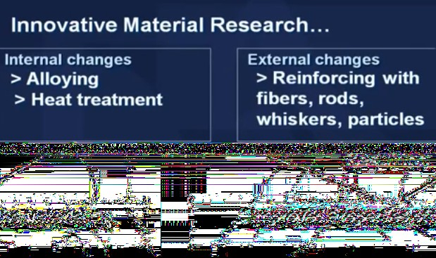
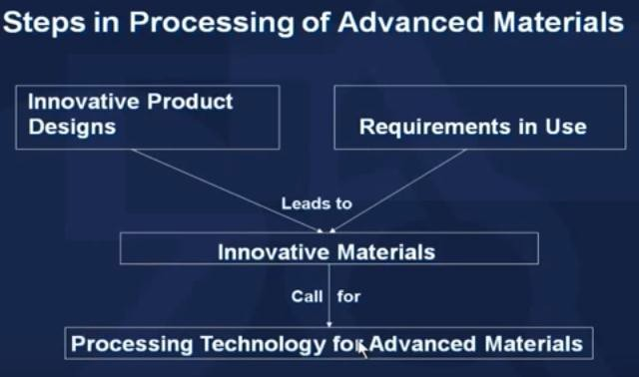
Assist.Prof.Dr. Dhia ahmed

Slide 3
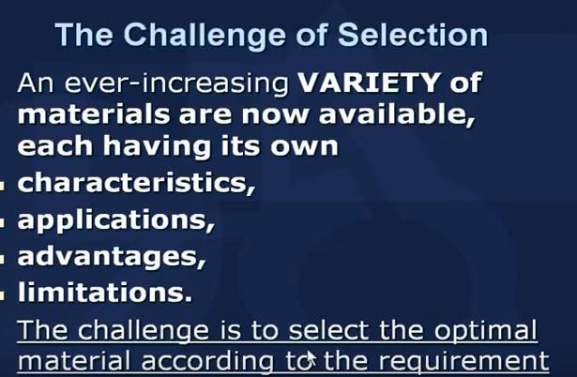
Assist.Prof.Dr. Dhia ahmed
Factors affect selecting the materials
Ex. Teethe brushes
Since there are large variety of materials

Slide 4
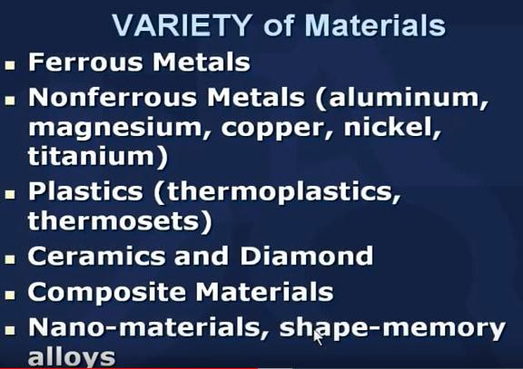
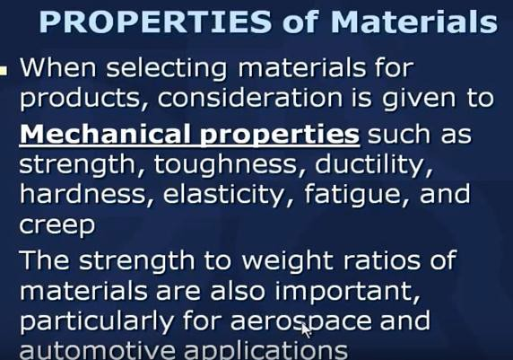
Assist.Prof.Dr. Dhia ahmed
The first step its important to understand the property of the material

Slide 5
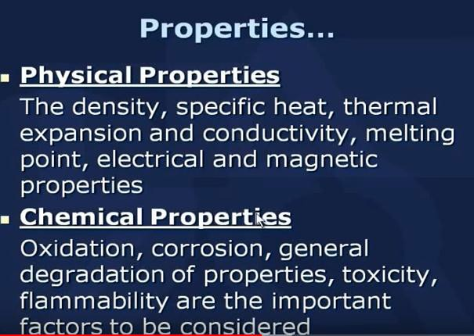
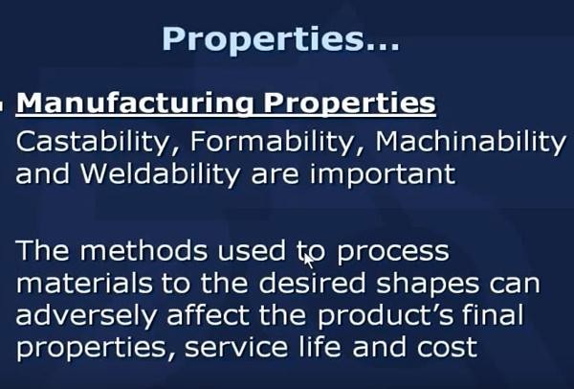
Assist.Prof.Dr. Dhia ahmed
Also

Slide 6
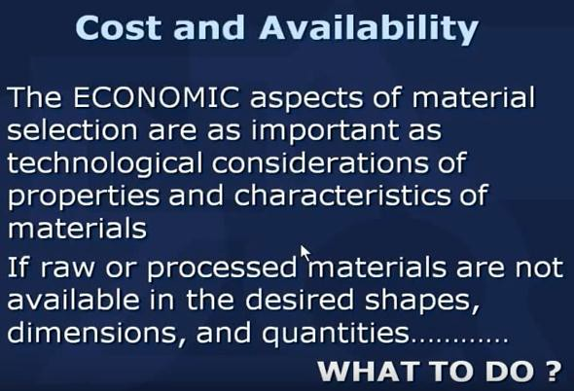
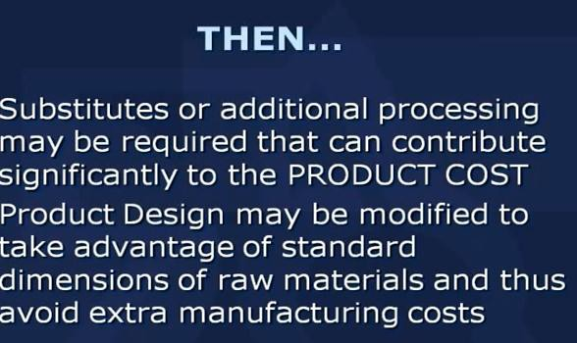
Assist.Prof.Dr. Dhia ahmed
Other properties shoud be taken into account

Slide 7

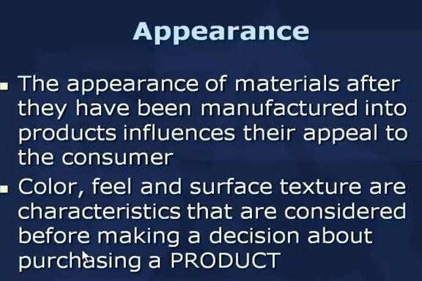
Assist.Prof.Dr. Dhia ahmed

Slide 8

Assist.Prof.Dr. Dhia ahmed

Slide 9
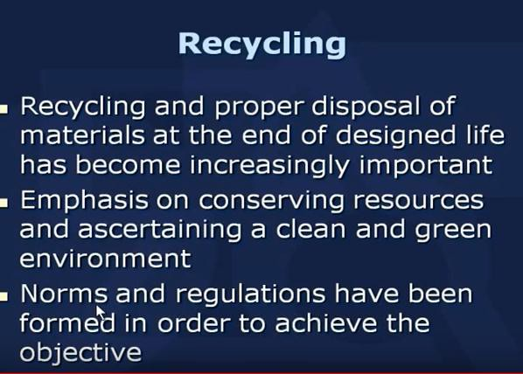

Assist.Prof.Dr. Dhia ahmed

Slide 10
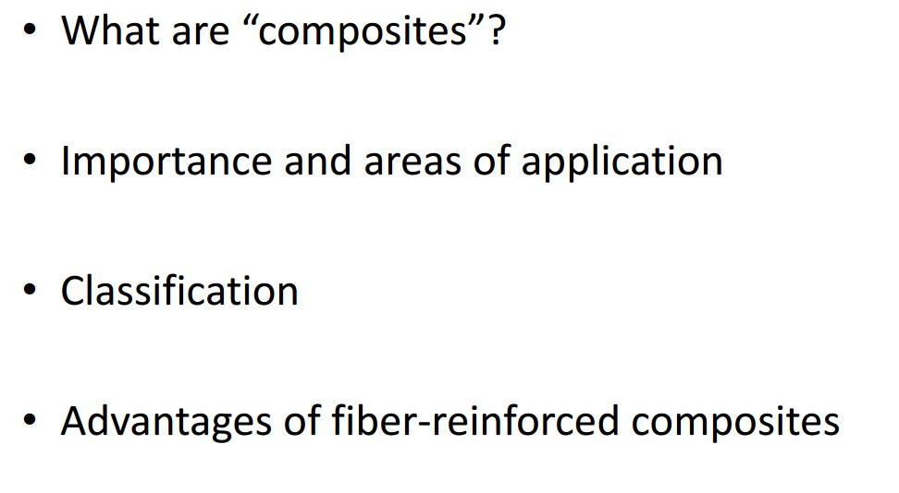
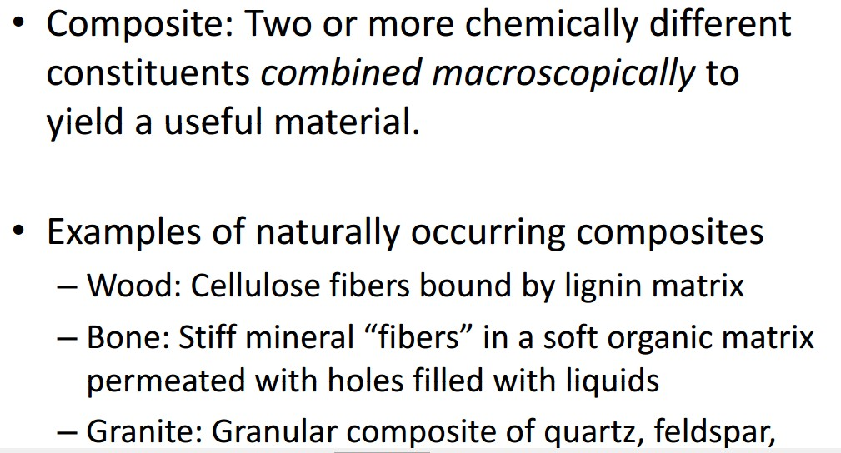
Assist.Prof.Dr. Dhia ahmed

Slide 11
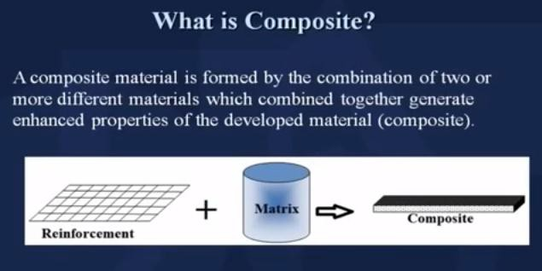
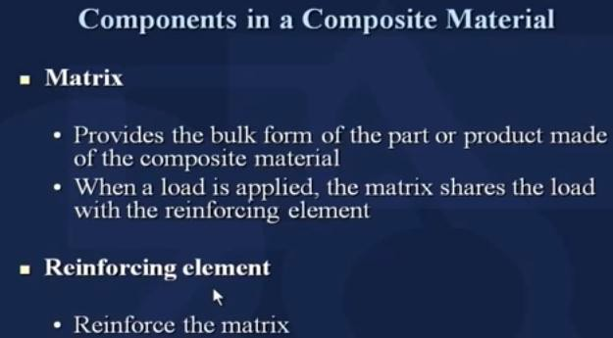
Assist.Prof.Dr. Dhia ahmed

Slide 12
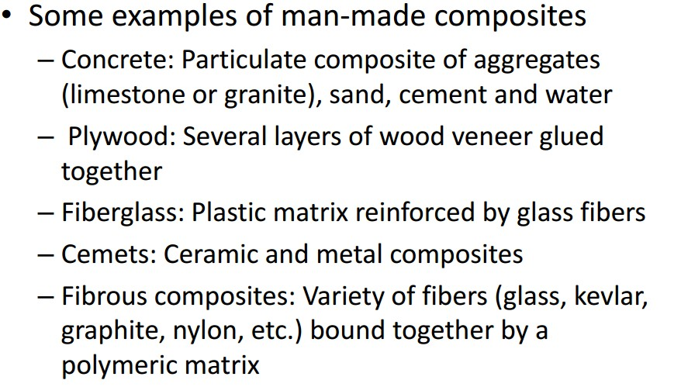
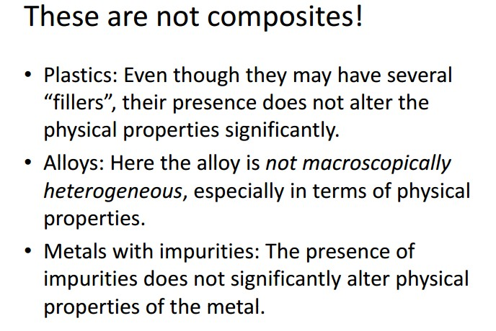
Assist.Prof.Dr. Dhia ahmed

Slide 13
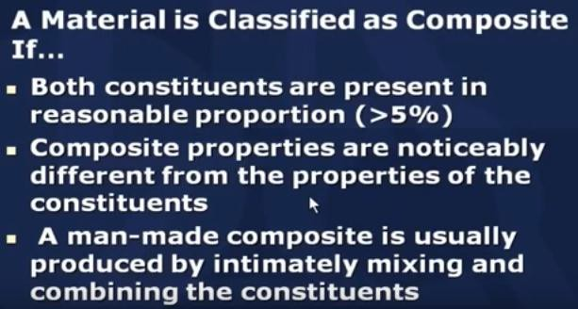
Assist.Prof.Dr. Dhia ahmed

